Slide 1
Basic of C Programming

Slide 2
Overview of C Programming Language
C was originally developed in the 1970s, by Dennis Ritchie at AT&T Bell Labs, Inc.
C is a mid level, general–purpose structured procedural oriented programming language. Instructions of C consists of terms that are very closely same to algebraic expressions, consisting of certain English keywords such as if, else, for ,do and while etc.
C contains certain additional features that allows it to be used at a lower level, acting as bridge between machine language and the high level languages.
These allows C to be used for system programming as well as for applications programming.

Slide 3

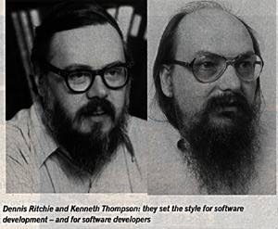

Slide 4

Basic Structure of C Programming
Standard Include Statements
#include<stdio.h>
#include<conio.h>
void main()
{
}
Main function
Header Files

Slide 5
- Explanation –
1. #include<stdio.h> - Includes the standard input output library functions. The printf() function is defined in stdio.h .
2. void main() - The main() function is the entry point of every program in c language.
3. printf() - The printf() function is used to print data on the console.

Slide 6
The Character set of ‘C’ -
C language consist of some characters set, numbers and some special symbols. The character set of C consist of all the alphabets of English language.
C consist of the followings –
Alphabets | a to z, A to Z
Numeric | 0,1 to 9
Special Symbols | {}, [], ?, +, -, *, /, %, ! etc.

Slide 7
The Character set of ‘C’ -
Token - The smallest words formed from the character set are known as tokens.
The following different types of token are used in C –
Identifiers
Variables
Keywords
Constants
Operators
Punctuators

Slide 8
Identifiers in C -
A 'C' program consist of two types of elements –
User Defined
System Defined
Identifiers is nothing but a name given to these elements.
An identifier is a word used by a programmer to name a variable , function or label.

Slide 9

Thank you…

